Slide 1
Module 1: Networking Today
Introduction to Networks v7.0 (ITN)
Notes:
Cisco Networking Academy Program
Introduction to Networks v7.0 (ITN)
Module 1: Networking Today

Slide 2
Module Objectives
Module Title: Networking Today
Module Objective: Explain the advances in modern technologies.
Topic Title | Topic Objective
Networks Affect our Lives | Explain how networks affect our daily lives.
Network Components | Explain how host and network devices are used.
Network Representations and Topologies | Explain network representations and how they are used in network topologies.
Common Types of Networks | Compare the characteristics of common types of networks.
Internet Connections | Explain how LANs and WANs interconnect to the internet.
Reliable Networks | Describe the four basic requirements of a reliable network.
Network Trends | Explain how trends such as BYOD, online collaboration, video, and cloud computing are changing the way we interact.
Network Security | Identify some basic security threats and solution for all networks.
The IT Professional | Explain employment opportunities in the networking field.
Notes:
2
1 – Networking Today
1.0.2 – What will I learn to do in this module?

Slide 3
1.1 Networks Affect Our Lives
Notes:
1 – Networking Today
1.1 – Networks Affect Our Lives

Slide 4
Networking Today Networks Connect Us
Communication is almost as important to us as our reliance on air, water, food, and shelter. In today’s world, through the use of networks, we are connected like never before.
Notes:
1 – Networking Today
1.1 – Networks Affect our Lives
1.1.1 – Networks Connect Us

Slide 5
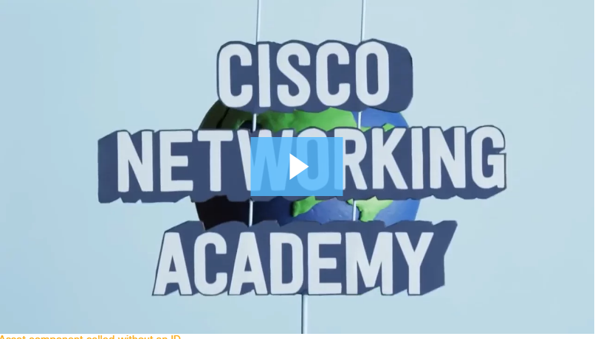
Video – The Cisco Networking Academy Learning Experience
Networking Today
Cisco Networking Academy: learn how we use technology to make the world a better place.
Notes:
1 – Networking Today
1.1 – Networks Affect our Lives
1.1.2 – Video – The Cisco Networking Academy Learning Experience

Slide 6

Networking Today No Boundaries
World without boundaries
Global communities
Human network
Notes:
1 – Networking Today
1.1 – Networks Affect our Lives
1.1.3 No Boundaries

Slide 7
1.2 Network Components
Notes:
1 – Networking Today
1.2 – Network Components

Slide 8
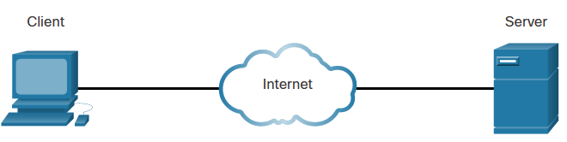
Network Components Host Roles
Every computer on a network is called a host or end device.
Servers are computers that provide information to end devices:
email servers
web servers
file server
Clients are computers that send requests to the servers to retrieve information:
web page from a web server
email from an email server
Server Type | Description
Email | Email server runs email server software. Clients use client software to access email.
Web | Web server runs web server software. Clients use browser software to access web pages.
File | File server stores corporate and user files. The client devices access these files.
Notes:
1 – Networking Today
1.2 – Network Components
1.2.1– Host Roles

Slide 9
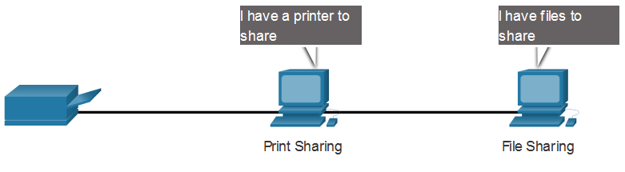
Network Components Peer-to-Peer
It is possible to have a device be a client and a server in a Peer-to-Peer Network. This type of network design is only recommended for very small networks.
Advantages | Disadvantages
Easy to set up | No centralized administration
Less complex | Not as secure
Lower cost | Not scalable
Used for simple tasks: transferring files and sharing printers | Slower performance
Notes:
1 – Networking Today
1.2 – Network Components
1.2.2 – Peer-to-Peer

Slide 10
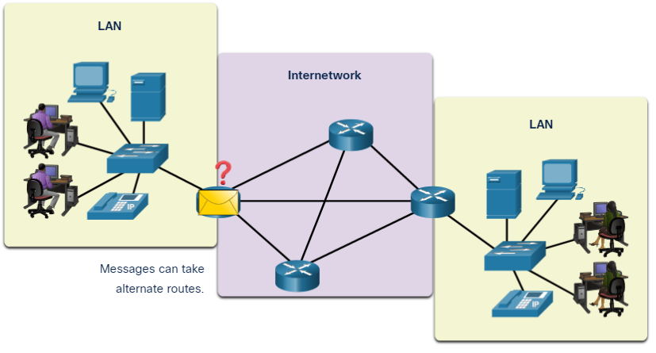
Network Components End Devices
An end device is where a message originates from or where it is received. Data originates with an end device, flows through the network, and arrives at an end device.
Notes:
1 – Networking Today
1.2 – Network Components
1.2.3 – End Devices

Slide 11
Network Components Intermediary Network Devices
An intermediary device interconnects end devices. Examples include switches, wireless access points, routers, and firewalls.
Management of data as it flows through a network is also the role of an intermediary device, including:
Regenerate and retransmit data signals.
Maintain information about what pathways exist in the network.
Notify other devices of errors and communication failures.
Notes:
1 – Networking Today
1.2 – Network Components
1.2.4 – Intermediary Network Devices

Slide 12
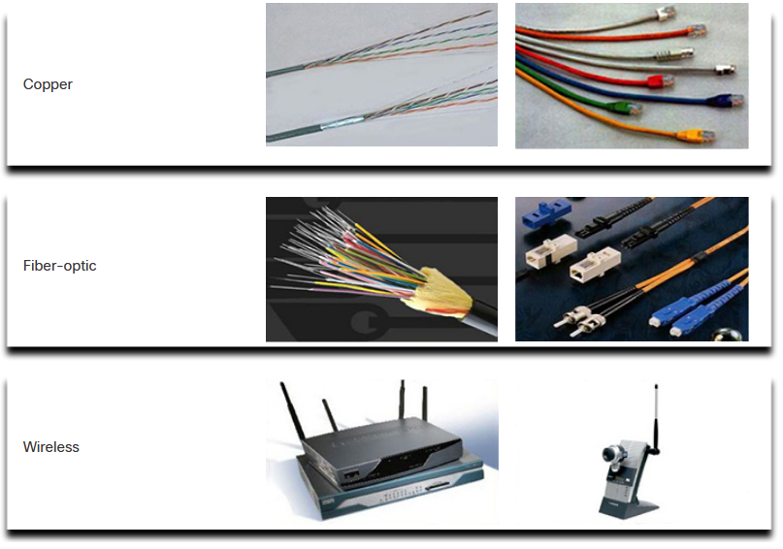
Network Components Network Media
Communication across a network is carried through a medium which allows a message to travel from source to destination.
Media Types | Description
Metal wires within cables | Uses electrical impulses
Glass or plastic fibers within cables (fiber-optic cable) | Uses pulses of light.
Wireless transmission | Uses modulation of specific frequencies of electromagnetic waves.
Notes:
1 – Networking Today
1.2 – Network Components
1.2.5 – Network Media
1.2.6 – Check Your Understanding – Network Components

Slide 13
1.3 Network Representations and Topologies
Notes:
1 – Networking Today
1.3 – Network Representations and Topologies

Slide 14
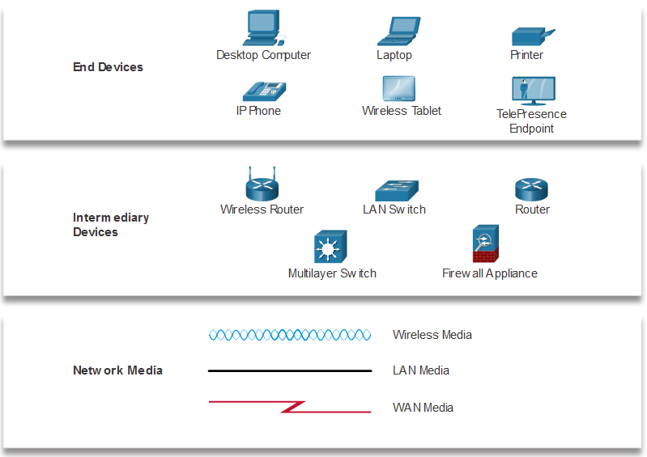
Network Representations and Topologies Network Representations
Network diagrams, often called topology diagrams, use symbols to represent devices within the network.
Important terms to know include:
Network Interface Card (NIC)
Physical Port
Interface
Note: Often, the terms port and interface are used interchangeably
Notes:
1 – Networking Today
1.3 – Network Representations and Topologies
1.3.1 – Network Representations

Slide 15
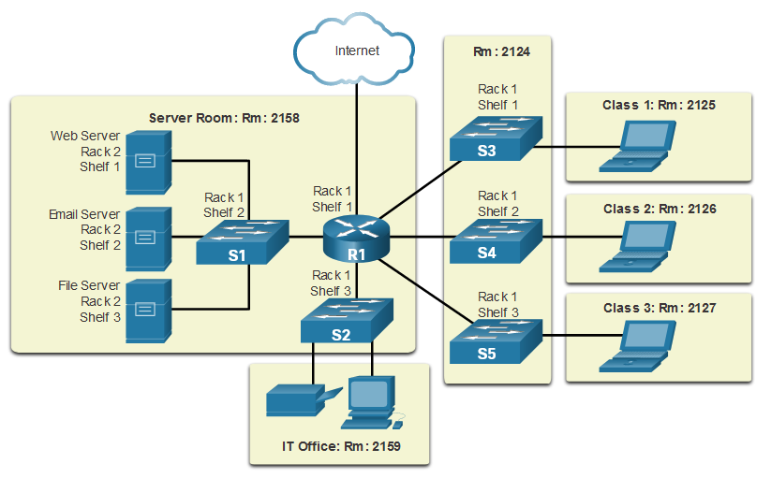
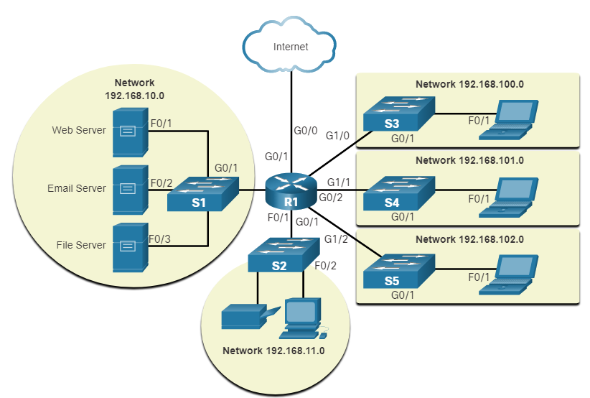
Network Representations and Topologies Topology Diagrams
Physical topology diagrams illustrate the physical location of intermediary devices and cable installation.
Logical topology diagrams illustrate devices, ports, and the addressing scheme of the network.
Notes:
1 – Networking Today
1.3 – Network Representations and Topologies
1.3.2 – Topology Diagrams
1.3.3 – Check Your Understanding – Network Representation and Topologies

Slide 16
1.4 Common Types of Networks
Notes:
1 – Networking Today
1.4 – Common Types of Networks

Slide 17
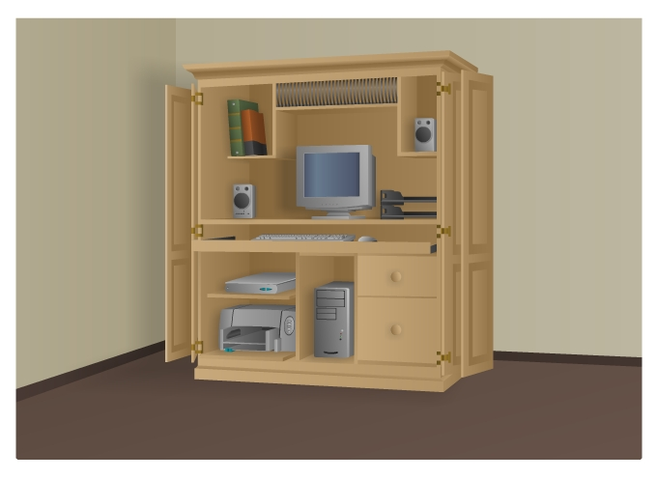
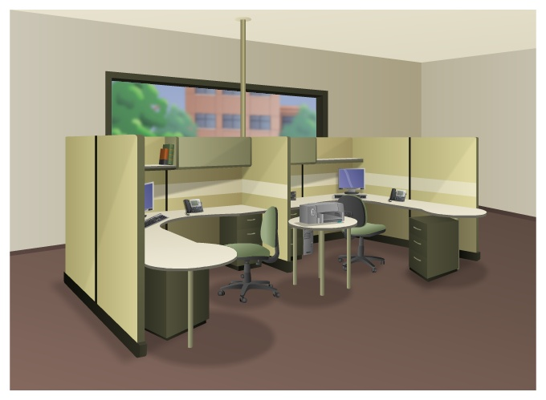
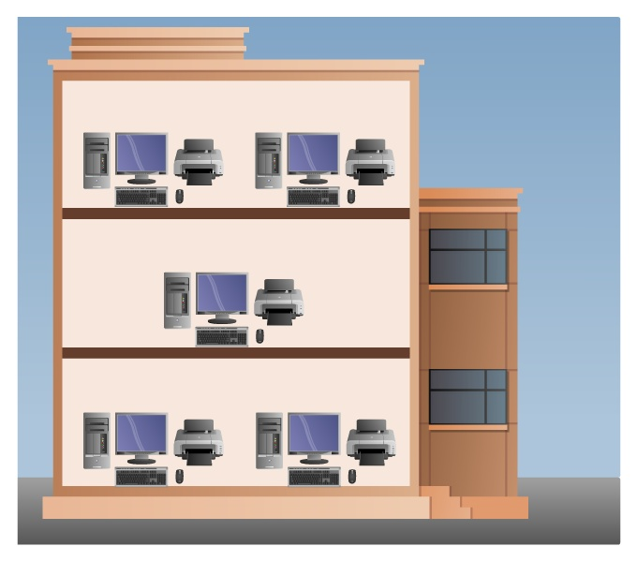
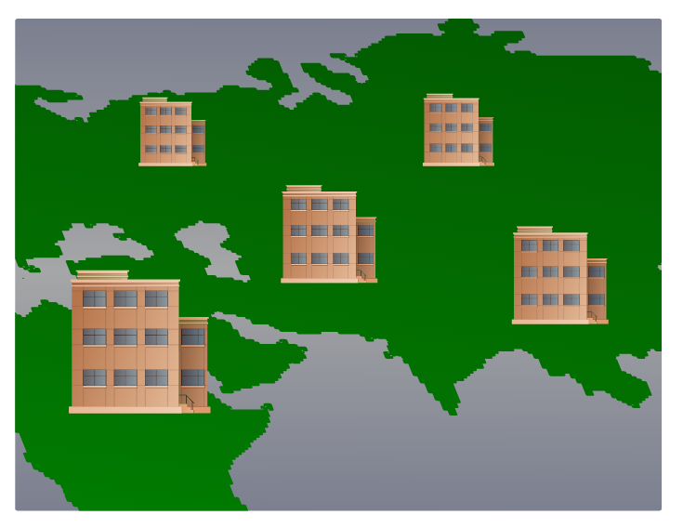
Common Types of Networks Networks of Many Sizes
Small Home Networks – connect a few computers to each other and the Internet
Small Office/Home Office – enables computer within a home or remote office to connect to a corporate network
Medium to Large Networks – many locations with hundreds or thousands of interconnected computers
World Wide Networks – connects hundreds of millions of computers world-wide – such as the internet
Small Home SOHO
Medium/Large World Wide
Notes:
1 – Networking Today
1.4 – Common Types of Networks
1.4.1 – Networks of Many Sizes

Slide 18
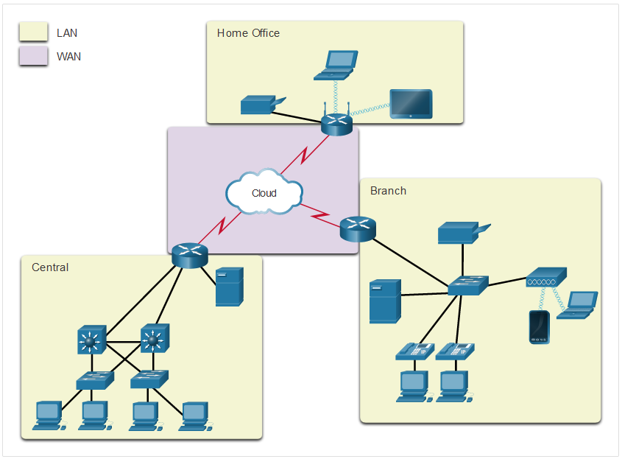
Common Types of Networks LANs and WANs
Network infrastructures vary greatly in terms of:
Size of the area covered
Number of users connected
Number and types of services available
Area of responsibility
Two most common types of networks:
Local Area Network (LAN)
Wide Area Network (WAN).
Notes:
1 – Networking Today
1.4 – Common Types of Networks
1.4.2 – LANs and WANs

Slide 19
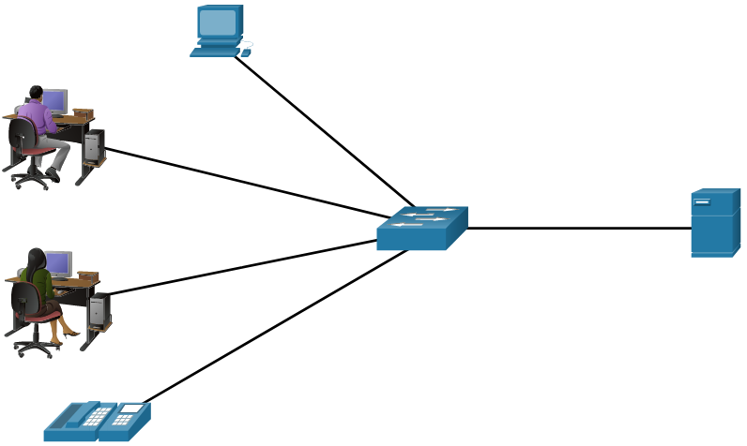
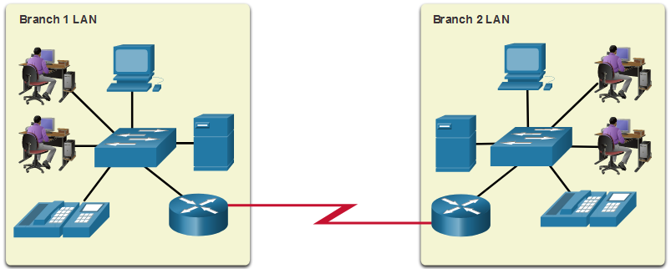
Common Types of Networks LANs and WANs (cont.)
A LAN is a network infrastructure that spans a small geographical area.
A WAN is a network infrastructure that spans a wide geographical area.
LAN | WAN
Interconnect end devices in a limited area. | Interconnect LANs over wide geographical areas.
Administered by a single organization or individual. | Typically administered by one or more service providers.
Provide high-speed bandwidth to internal devices. | Typically provide slower speed links between LANs.
Notes:
1 – Networking Today
1.4 – Common Types of Networks
1.4.2 – LANs and WANs (cont.)

Slide 20
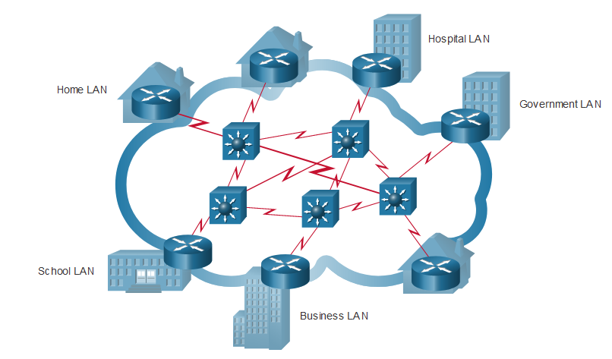
Common Types of Networks The Internet
The internet is a worldwide collection of interconnected LANs and WANs.
LANs are connected to each other using WANs.
WANs may use copper wires, fiber optic cables, and wireless transmissions.
The internet is not owned by any individual or group. The following groups were developed to help maintain structure on the internet:
IETF
ICANN
IAB
Notes:
1 – Networking Today
1.4 – Common Types of Networks
1.4.3 – The Internet

Slide 21
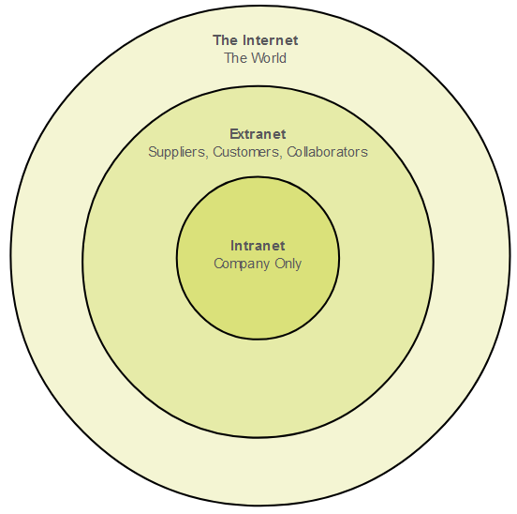
Common Types of Networks Intranets and Extranets
An intranet is a private collection of LANs and WANs internal to an organization that is meant to be accessible only to the organizations members or others with authorization.
An organization might use an extranet to provide secure access to their network for individuals who work for a different organization that need access to their data on their network.
Notes:
1 – Networking Today
1.4 – Common Types of Networks
1.4.4 – Intranets and Extranets
1.4.5 – Check Your Understanding – Common Types of Networks

Slide 22
1.5 Internet Connections
Notes:
1 – Networking Today
1.5 – Internet Connections

Slide 23

Internet Connections Internet Access Technologies
There are many ways to connect users and organizations to the internet:
Popular services for home users and small offices include broadband cable, broadband digital subscriber line (DSL), wireless WANs, and mobile services.
Organizations need faster connections to support IP phones, video conferencing and data center storage.
Business-class interconnections are usually provided by service providers (SP) and may include: business DSL, leased lines, and Metro Ethernet.
Notes:
1 – Networking Today
1.5 – Internet Connections
1.5.1 – Internet Access Technologies

Slide 24
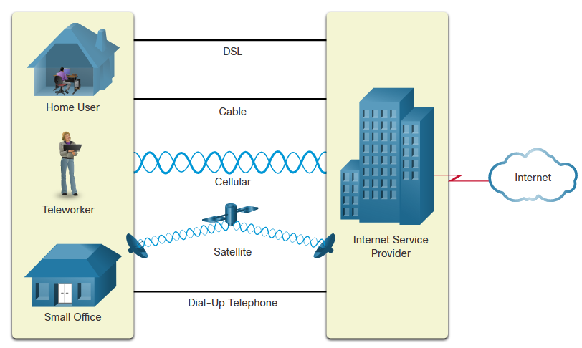
Internet Connections Home and Small Office Internet Connections
Connection | Description
Cable | high bandwidth, always on, internet offered by cable television service providers.
DSL | high bandwidth, always on, internet connection that runs over a telephone line.
Cellular | uses a cell phone network to connect to the internet.
Satellite | major benefit to rural areas without Internet Service Providers.
Dial-up telephone | an inexpensive, low bandwidth option using a modem.
Notes:
1 – Networking Today
1.5 – Internet Connections
1.5.2 – Home and Small Office Internet Connections

Slide 25
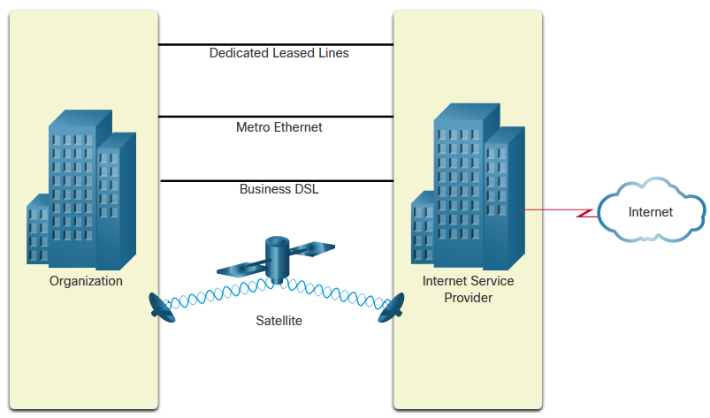
Internet Connections Businesses Internet Connections
Corporate business connections may require:
higher bandwidth
dedicated connections
managed services
Type of Connection | Description
Dedicated Leased Line | These are reserved circuits within the service provider’s network that connect distant offices with private voice and/or data networking.
Ethernet WAN | This extends LAN access technology into the WAN.
DSL | Business DSL is available in various formats including Symmetric Digital Subscriber Lines (SDSL).
Satellite | This can provide a connection when a wired solution is not available.
Notes:
1 – Networking Today
1.5 – Internet Connections
1.5.3 – Businesses Internet Connections

Slide 26
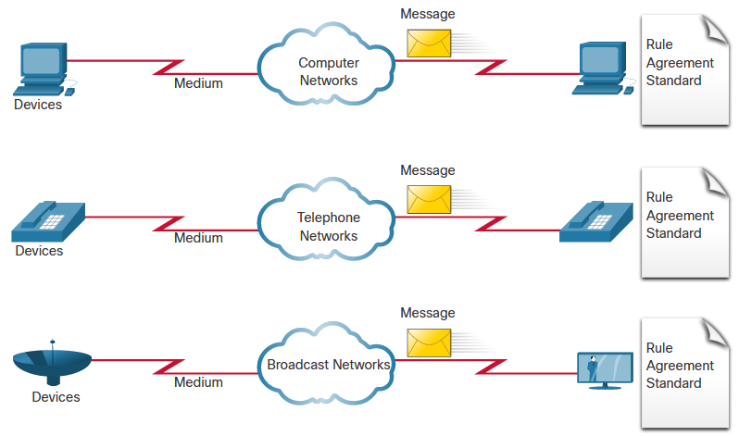
Internet Connections The Converging Network
Before converged networks, an organization would have been separately cabled for telephone, video, and data. Each of these networks would use different technologies to carry the signal.
Each of these technologies would use a different set of rules and standards.
Notes:
1 – Networking Today
1.5 – Internet Connections
1.5.5 – The Converging Network

Slide 27
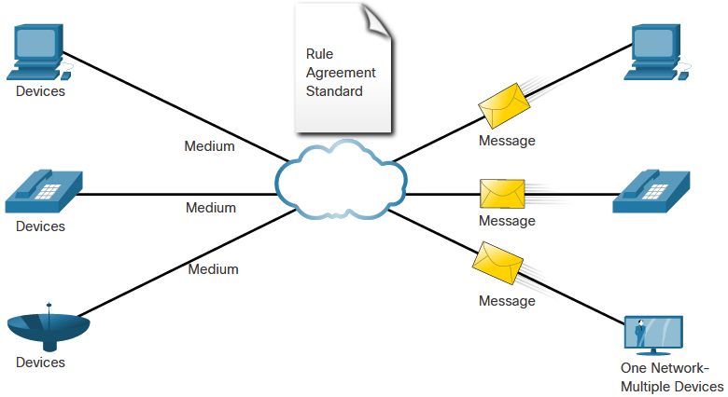
Internet Connections The Converging Network (Cont.)
Converged data networks carry multiple services on one link including:
data
voice
video
Converged networks can deliver data, voice, and video over the same network infrastructure. The network infrastructure uses the same set of rules and standards.
Notes:
1 – Networking Today
1.5 – Internet Connections
1.5.5 – The Converging Network (Cont.)

Slide 28
Internet Connections Video – Download and Install Packet Tracer
This video will demonstrate the download and install process of Packet Tracer.
Notes:
1 – Networking Today
1.5 – Internet Connections
1.5.5 – Video – Download and Install Packet Tracer

Slide 29
Internet Connections Video – Getting Started in Cisco Packet Tracer
This video will cover the following:
Navigate the Packet Tracer interface
Customize the Packet Tracer Interface
Notes:
1 – Networking Today
1.5 – Internet Connections
1.5.6 – Video – Getting Started in Cisco Packet Tracer

Slide 30
Internet Connections Packet Tracer – Network Representation
In this Packet tracer you will do the following:
The network model in this activity incorporates many of the technologies that you will master in your CCNA studies.
Note: It is not important that you understand everything you see and do in this activity.
Notes:
1 – Networking Today
1.5 – Internet Connections
1.5.7 – Packet Tracer – Network Representation

Slide 31
1.6 Reliable Networks
Notes:
1 – Networking Today
1.6 – Reliable Networks

Slide 32
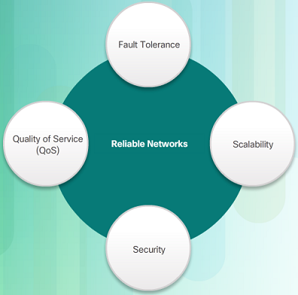
Reliable Network Network Architecture
Network Architecture refers to the technologies that support the infrastructure that moves data across the network.
There are four basic characteristics that the underlying architectures need to address to meet user expectations:
Fault Tolerance
Scalability
Quality of Service (QoS)
Security
Notes:
1 – Networking Today
1.6 – Reliable Networks
1.6.1 – Network Architecture

Slide 33
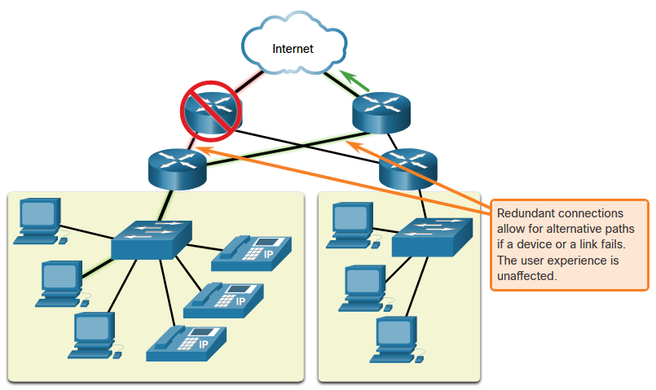
Reliable Network Fault Tolerance
A fault tolerant network limits the impact of a failure by limiting the number of affected devices. Multiple paths are required for fault tolerance.
Reliable networks provide redundancy by implementing a packet switched network:
Packet switching splits traffic into packets that are routed over a network.
Each packet could theoretically take a different path to the destination.
This is not possible with circuit-switched networks which establish dedicated circuits.
Notes:
1 – Networking Today
1.6 – Reliable Networks
1.6.2 – Fault Tolerance

Slide 34
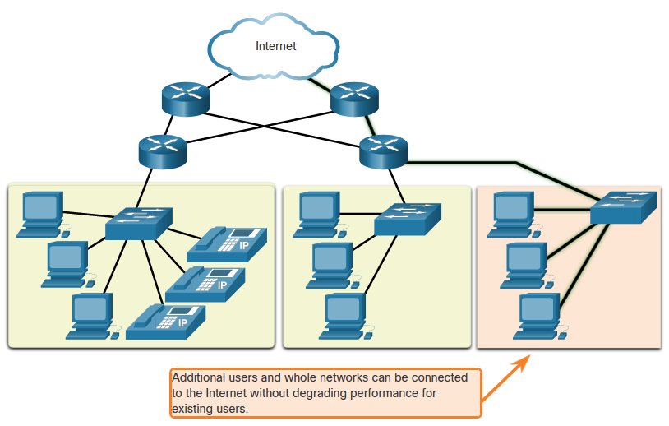
Reliable Network Scalability
A scalable network can expand quickly and easily to support new users and applications without impacting the performance of services to existing users.
Network designers follow accepted standards and protocols in order to make the networks scalable.
Notes:
1 – Networking Today
1.6 – Reliable Networks
1.6.3 – Scalability

Slide 35
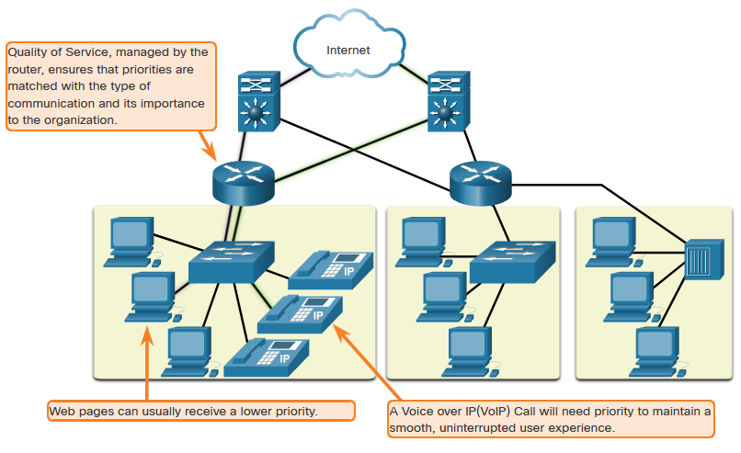
Reliable Network Quality of Service
Voice and live video transmissions require higher expectations for those services being delivered.
Have you ever watched a live video with constant breaks and pauses? This is caused when there is a higher demand for bandwidth than available – and QoS isn’t configured.
Quality of Service (QoS) is the primary mechanism used to ensure reliable delivery of content for all users.
With a QoS policy in place, the router can more easily manage the flow of data and voice traffic.
Notes:
1 – Networking Today
1.6 – Reliable Networks
1.6.4 – Quality of Service

Slide 36
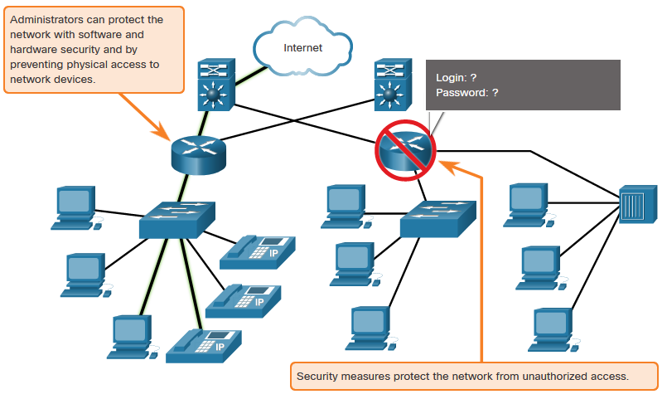
Reliable Network Network Security
There are two main types of network security that must be addressed:
Network infrastructure security
Physical security of network devices
Preventing unauthorized access to the devices
Information Security
Protection of the information or data transmitted over the network
Three goals of network security:
Confidentiality – only intended recipients can read the data
Integrity – assurance that the data has not be altered with during transmission
Availability – assurance of timely and reliable access to data for authorized users
Notes:
1 – Networking Today
1.6 – Reliable Networks
1.6.5 – Network Security
1.6.6 – Check Your Understanding – Reliable Networks

Slide 37
1.7 Network Trends
Notes:
1 – Networking Today
1.7 – Network Trends

Slide 38

Network Trends Recent Trends
The role of the network must adjust and continually transform in order to be able to keep up with new technologies and end user devices as they constantly come to the market.
Several new networking trends that effect organizations and consumers:
Bring Your Own Device (BYOD)
Online collaboration
Video communications
Cloud computing
Notes:
1 – Networking Today
1.7 – Network Trends
1.7.1 – Recent Trends

Slide 39

Network Trends Bring Your Own Device
Bring Your Own Device (BYOD) allows users to use their own devices giving them more opportunities and greater flexibility.
BYOD allows end users to have the freedom to use personal tools to access information and communicate using their:
Laptops
Netbooks
Tablets
Smartphones
E-readers
BYOD means any device, with any ownership, used anywhere.
Notes:
1 – Networking Today
1.7 – Network Trends
1.7.2 – Bring Your Own Device (BYOD)

Slide 40
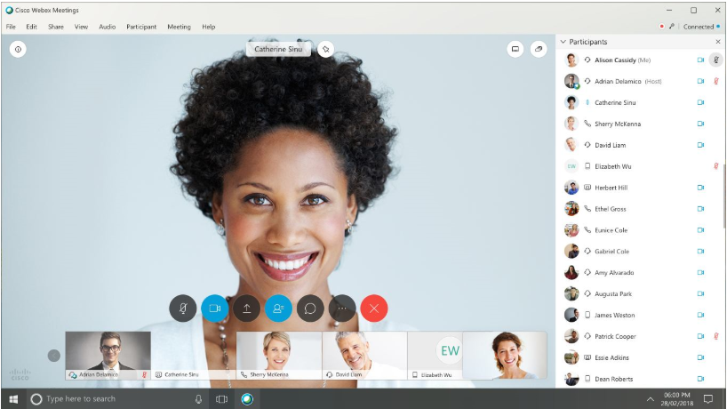
Network Trends Online Collaboration
Collaborate and work with others over the network on joint projects.
Collaboration tools including Cisco WebEx (shown in the figure) gives users a way to instantly connect and interact.
Collaboration is a very high priority for businesses and in education.
Cisco Webex Teams is a multifunctional collaboration tool.
send instant messages
post images
post videos and links
Notes:
1 – Networking Today
1.7 – Network Trends
1.7.3 – Online Collaboration

Slide 41
Network Trends Video Communication
Video calls are made to anyone, regardless of where they are located.
Video conferencing is a powerful tool for communicating with others.
Video is becoming a critical requirement for effective collaboration.
Cisco TelePresence powers is one way of working where everyone, everywhere.
Notes:
1 – Networking Today
1.7 – Network Trends
1.7.4 – Video Communication

Slide 42
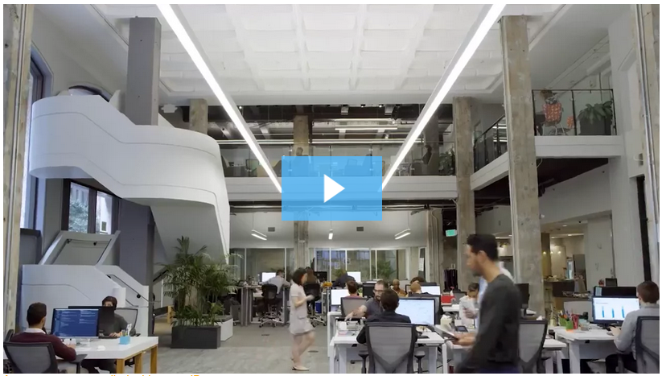
Network Trends Video – Cisco WebEx for Huddles
Notes:
1 – Networking Today
1.7 – Network Trends
1.7.5 – Video – Cisco WebEx for Huddles

Slide 43
Network Trends Cloud Computing
Cloud computing allows us to store personal files or backup our data on servers over the internet.
Applications can also be accessed using the Cloud.
Allows businesses to deliver to any device anywhere in the world.
Cloud computing is made possible by data centers.
Smaller companies that can’t afford their own data centers, lease server and storage services from larger data center organizations in the Cloud.
Notes:
1 – Networking Today
1.7 – Network Trends
1.7.6 – Cloud Computing

Slide 44
Network Trends Cloud Computing (Cont.)
Four types of Clouds:
Public Clouds
Available to the general public through a pay-per-use model or for free.
Private Clouds
Intended for a specific organization or entity such as the government.
Hybrid Clouds
Made up of two or more Cloud types – for example, part custom and part public.
Each part remains a distinctive object but both are connected using the same architecture.
Custom Clouds
Built to meet the needs of a specific industry, such as healthcare or media.
Can be private or public.
Notes:
1 – Networking Today
1.7 – Network Trends
1.7.6 – Cloud Computing (Cont.)

Slide 45
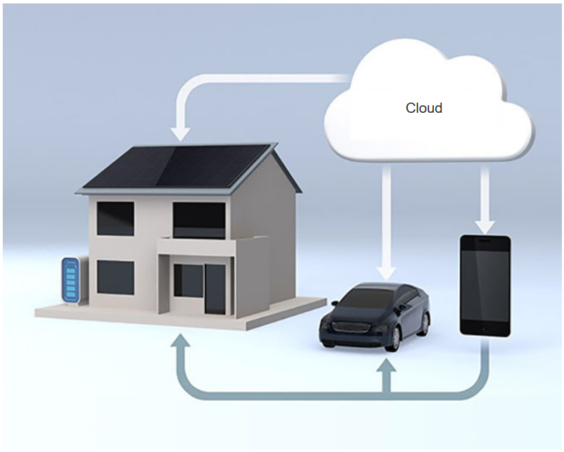
Network Trends Technology Trends in the Home
Smart home technology is a growing trend that allows technology to be integrated into every-day appliances which allows them to interconnect with other devices.
Ovens might know what time to cook a meal for you by communicating with your calendar on what time you are scheduled to be home.
Smart home technology is currently being developed for all rooms within a house.
Notes:
1 – Networking Today
1.7 – Network Trends
1.7.7 – Technology Trends in the Home

Slide 46
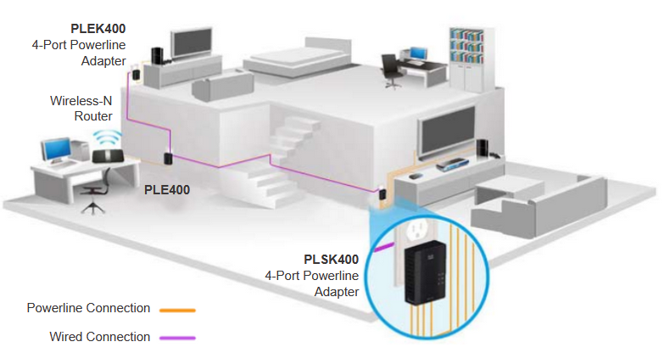
Network Trends Powerline Networking
Powerline networking can allow devices to connect to a LAN where data network cables or wireless communications are not a viable option.
Using a standard powerline adapter, devices can connect to the LAN wherever there is an electrical outlet by sending data on certain frequencies.
Powerline networking is especially useful when wireless access points cannot reach all the devices in the home.
Notes:
1 – Networking Today
1.7 – Network Trends
1.7.8 – Powerline Networking

Slide 47
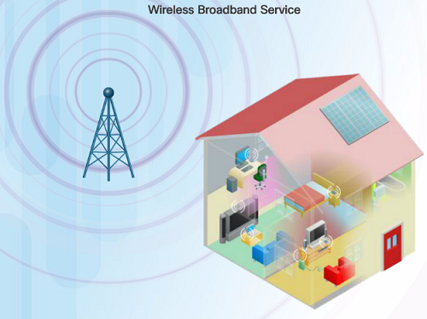
Network Trends Wireless Broadband
In addition to DSL and cable, wireless is another option used to connect homes and small businesses to the internet.
More commonly found in rural environments, a Wireless Internet Service Provider (WISP) is an ISP that connects subscribers to designated access points or hotspots.
Wireless broadband is another solution for the home and small businesses.
Uses the same cellular technology used by a smart phone.
An antenna is installed outside the house providing wireless or wired connectivity for devices in the home.
Notes:
1 – Networking Today
1.7 – Network Trends
1.7.9 – Wireless Broadband
1.7.10 – Check Your Understanding – Network Trends

Slide 48
1.8 Network Security
Notes:
1 – Networking Today
1.8 – Network Security

Slide 49
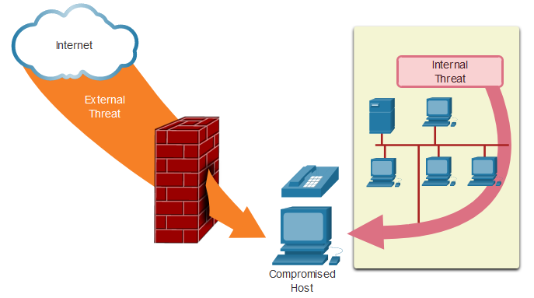
Network Security Security Threats
Network security is an integral part of networking regardless of the size of the network.
The network security that is implemented must take into account the environment while securing the data, but still allowing for quality of service that is expected of the network.
Securing a network involves many protocols, technologies, devices, tools, and techniques in order to secure data and mitigate threats.
Threat vectors might be external or internal.
Notes:
1 – Networking Today
1.8 – Network Security
1.8.1 – Security Threats

Slide 50
Network Security Security Threats (Cont.)
External Threats:
Viruses, worms, and Trojan horses
Spyware and adware
Zero-day attacks
Threat Actor attacks
Denial of service attacks
Data interception and theft
Identity theft
Internal Threats:
lost or stolen devices
accidental misuse by employees
malicious employees
Notes:
1 – Networking Today
1.8 – Network Security
1.8.1 – Security Threats (Cont.)

Slide 51
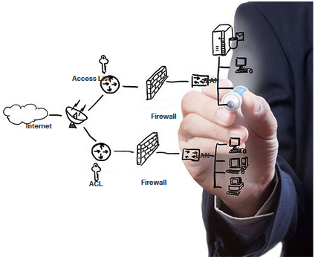
Network Security Security Solutions
Security must be implemented in multiple layers using more than one security solution.
Network security components for home or small office network:
Antivirus and antispyware software should be installed on end devices.
Firewall filtering used to block unauthorized access to the network.
Notes:
1 – Networking Today
1.8 – Network Security
1.8.2 – Security Solutions

Slide 52
Network Security Security Solutions (Cont.)
Larger networks have additional security requirements:
Dedicated firewall system
Access control lists (ACL)
Intrusion prevention systems (IPS)
Virtual private networks (VPN)
The study of network security starts with a clear understanding of the underlying switching and routing infrastructure.
Notes:
1 – Networking Today
1.8 – Network Security
1.8.2 – Security Solutions (Cont.)
1.8.3 – Check Your Understanding – Network Security

